Slide 1
LET’S PRACTICE POSSESSIVES!

Slide 2
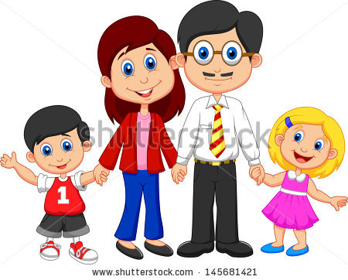
Marina and Eduardo have two children. THEIR names are Elisa and Mario.

Slide 3
What’s YOUR name? - My name is Nick.

Slide 4
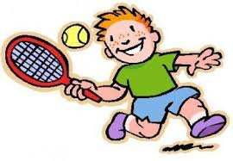
I like tennis. It is my favourite sport.

Slide 5
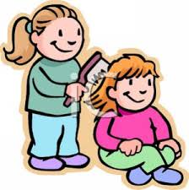
She is Mary. And this is her sister Andrea.

Slide 6
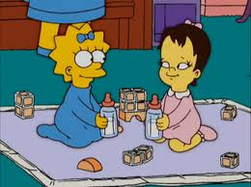
Maggie is two years old. Her cousin ling is one.

Slide 7
Marco and his wife live in England.

Slide 8
This is our school. We love going to school.

Slide 9
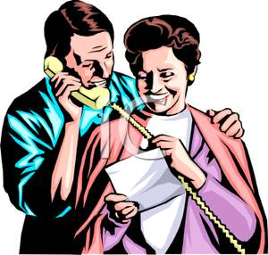
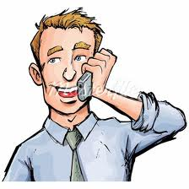
Alice and Tomás live in Spain. Their son lives in Australia.

Slide 10
John has one brother and two sisters. His brother is 18 and his two sisters are 17.

